Slide 1

Net-Zero 2030 Roadmap
This presentation outlines a practical roadmap for a mid-size manufacturer to achieve net-zero emissions by 2030.

Slide 2
Baseline Emissions and 2030 Target
Baseline emissions in 2023
150 ktCO2e total emissions
Emissions breakdown in 2023
Scope 1: 25 ktCO2e, Scope 2: 20 ktCO2e, Scope 3: 105 ktCO2e
2030 emissions target
Reduce to 60 ktCO2e, with 60 ktCO2e neutralized through high-durability removals
2030 emissions reduction plan
Scope 1: 1 ktCO2e, Scope 2: 0 ktCO2e, Scope 3: 59 ktCO2e
Neutralization plan
Utilize high-durability carbon removal methods like mineralization and BECCS

Slide 3

Abatement Levers and MAC Curve
This slide outlines the manufacturer's 12 prioritized abatement levers that can deliver 90 ktCO2e in annual emissions reductions by 2030, with 62% of the volume being cost-saving or near-zero cost. These levers include energy efficiency measures, process electrification, on-site solar, renewable PPAs, and logistics optimization.

Slide 4


100% Renewable Electricity: PPAs and On-site
Electricity Demand
On-site Solar PV
VPPA
Green Tariffs/EACs
Increasing from 58 GWh in 2024 to 75 GWh by 2030
5 MW DC rooftop/ground-mount system, generating ~6.5 GWh/yr from 2026
50 GWh/yr of solar/wind energy, starting in 2027 for a 10-year term
Used to top up to 100% renewable electricity, providing 3.5-18.5 GWh/yr, prior to the VPPA
The manufacturer's plan to achieve 100% renewable electricity by 2027 through a combination of on-site solar and a solar/wind virtual power purchase agreement (VPPA) demonstrates a comprehensive approach to decarbonizing its electricity supply.

Slide 5




Process Electrification Roadmap
Baseline and Targets
Equipment Plan
Phasing
Economics
The manufacturer's current process heat supply is 400,000 MMBtu/year, with natural gas accounting for 380,000 MMBtu. The 2030 target is to electrify 60% of the low and medium-temperature heat, integrate 20,000 MMBtu/year of recovered waste heat, and pilot one high-temperature electrification line.
The roadmap calls for installing 4 x 3 MW electric boilers, 6 x 1.2 MW industrial heat pumps (COP 2.5-3.0), and 3 x 1.5-2 MW electric IR/convective ovens. The plan also includes 4 MWhth of thermal storage for load shifting.
The phasing involves: 2024-2025 - FEED studies, pilots on one dryer line, utility interconnection upgrades; 2026-2027 - Phase 1 install (2 boilers, 3 heat pumps), controls tuning; 2028-2030 - Phase 2 scale (remaining boilers/heat pumps, 3 IR ovens), waste-heat integration.
The total capital expenditure for the process electrification initiative is estimated at $12 million. The annual savings are projected to be $1.2 million, with a simple payback of 10 years. The electrification is expected to increase the site's electricity load by approximately 25 GWh/year by 2030.

Slide 6


Economics: Capex, Opex, Payback
Initiative
Capex
Simple Payback
Compressed Air Program
$0.4 million
0.8 years
Logistics Optimization
$0.8 million
0.9 years
VFDs & Motor Optimization
$1 million
2.5 years
LED + Controls
$1.2 million
4.8 years
Waste Heat Recovery
$4 million
5.7 years
On-Site PV (5 MW + 2 MWh Storage)
$6.5 million
8 years
Fleet Electrification
$1.5 million
8.3 years
Process Electrification
$12 million
10 years
*Initiatives and Economics context

Slide 7
Execution Plan and Governance
Q1-Q2 2024
Q3 2024
Finalize governance charter, approve VPPA RFP, kick off leak surveys and lighting audits
Make go/no-go decision on VPPA, lock in incentives, mobilize wave-1 efficiency projects
Q2 2024
Shortlist VPPA bids, complete electrification FEED studies, secure utility interconnection approval queue positions
By end of 2024
Execute VPPA, award contract for on-site solar, issue supplier code of conduct, have live risk register

Slide 8
Risks and Mitigations
Electrification Performance Shortfall
PPA Basis/Price Risk and Counterparty Credit
Capex Overrun and Schedule Slip
Likelihood: Medium Impact: High Mitigation: Pilot on one line, include fallback gas trim, use thermal storage, and obtain vendor performance guarantees Owner: VP Operations
Likelihood: Medium Impact: High Mitigation: Utilize EPC wrap, include 15% contingency, stage-gate FEED, and implement weekly PMO controls Owner: PMO
Likelihood: Medium Impact: Medium-High Mitigation: Conduct hub selection analysis, add basis hedge, run multi-seller RFP, and consider credit insurance Owner: CFO / Energy Procurement
Long-Lead Equipment Delays (Transformers, Switchgear)
Policy/EAC Claim Changes (RECs Quality, Additionality)
Change Management & Operator Adoption
Likelihood: High Impact: Medium Mitigation: Procure early (NTP Q4), source from multiple vendors, and consider temporary rentals Owner: Supply Chain
Likelihood: Medium Impact: Medium Mitigation: Prioritize bundled VPPA, align with market-based reporting (GHG Protocol), and conduct annual assurance Owner: Sustainability
Likelihood: Medium Impact: Medium Mitigation: Provide formal training, update SOPs, implement incentive plans, and conduct kaizen cycles Owner: Plant Manager

Slide 9






Incentives and Funding by Region

Slide 10







Key Initiatives and Emissions Reduction
Energy Efficiency
Process Electrification
Renewable PPAs
Waste Heat Recovery

Slide 11




Stakeholder Engagement and Partnerships
Jane Smith
Michael Johnson
Sarah Lee
David Wong
Sustainability Manager, Supplier X
Policy Advisor, Department of Energy
Product Manager, ABC Technology Solutions
CEO, Renewable Energy Partners

Slide 12
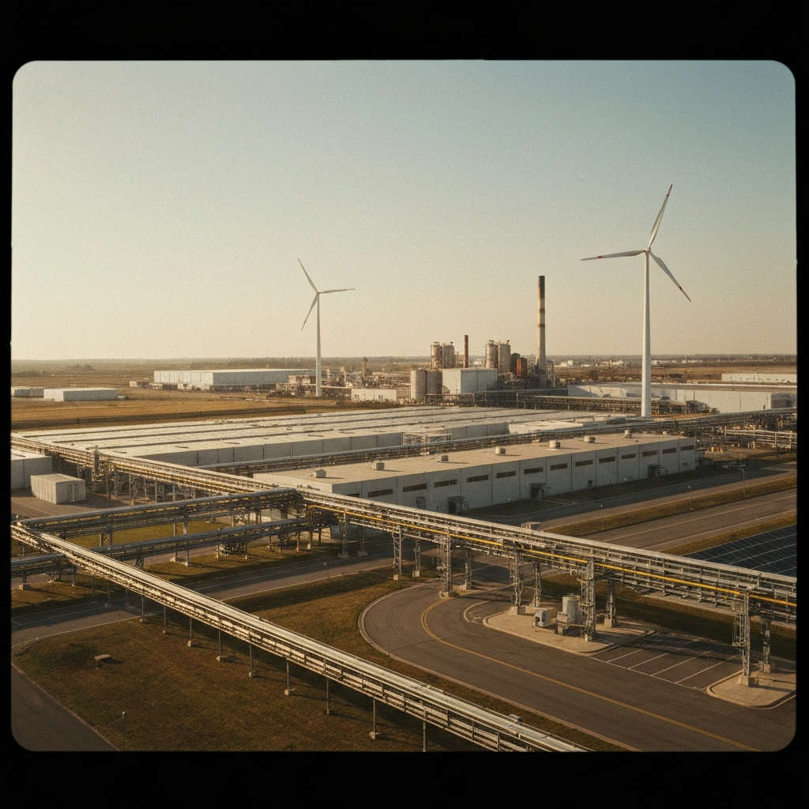
The comprehensive Net-Zero 2030 Roadmap provides a clear path for the mid-size manufacturer to achieve its decarbonization goals by 2030. By implementing a suite of cost-effective abatement levers, transitioning to 100% renewable electricity, and electrifying critical processes, the company can reduce emissions by over 90 ktCO2e annually while maintaining financial viability. Securing necessary funding and incentives, engaging stakeholders, and closely monitoring execution will be crucial next steps to ensure successful delivery of the net-zero target.

